Slide 1
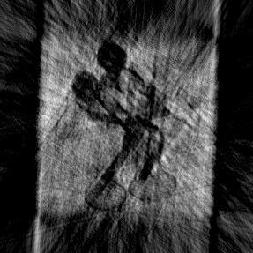
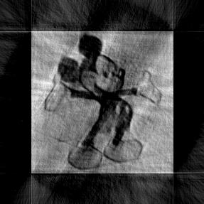
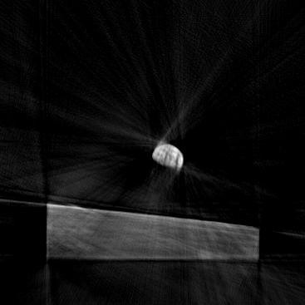
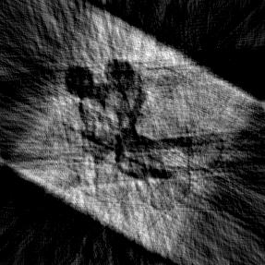
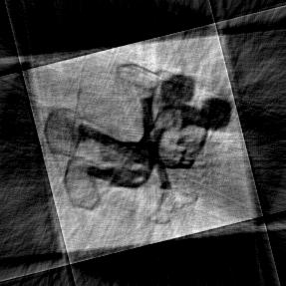
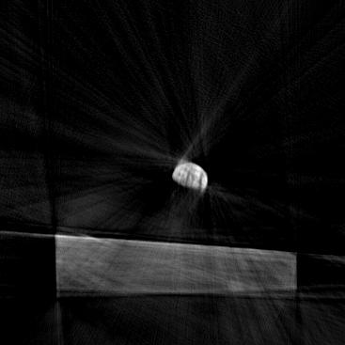
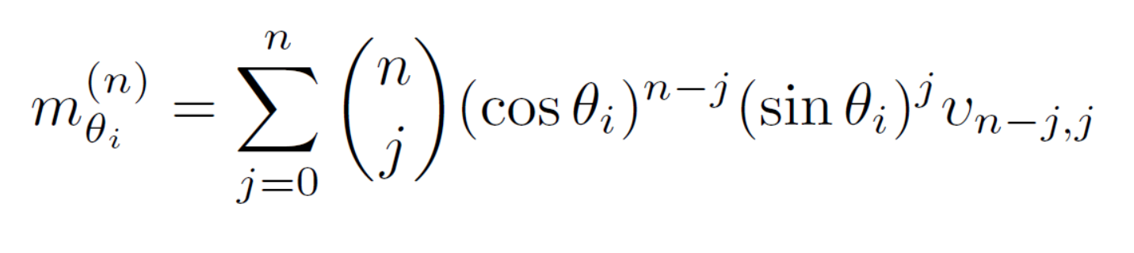
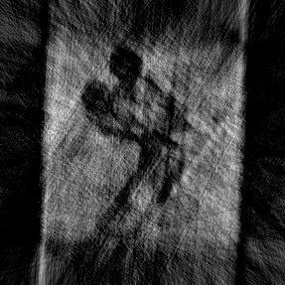
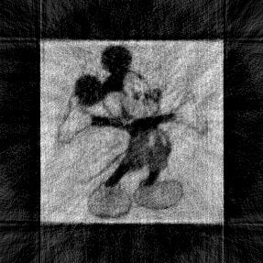

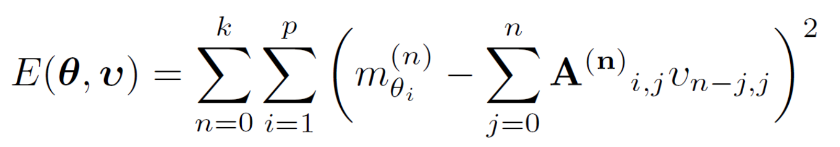
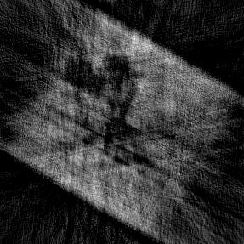
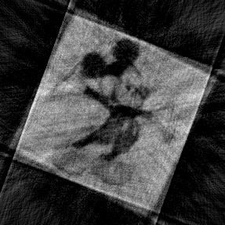
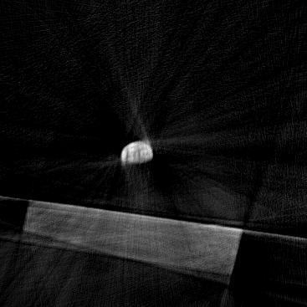
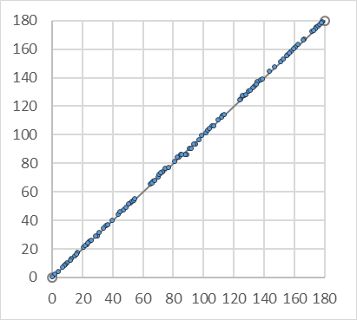
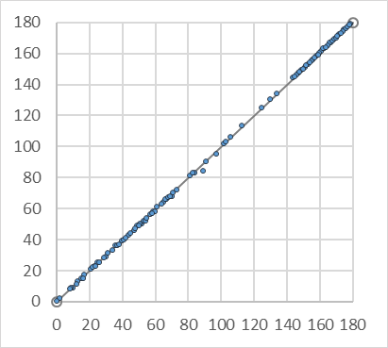
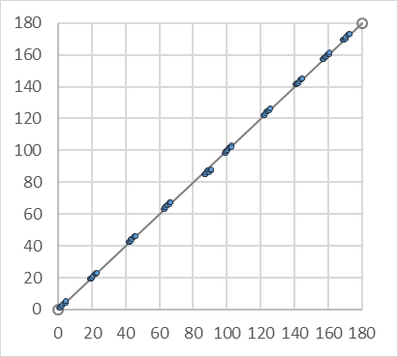
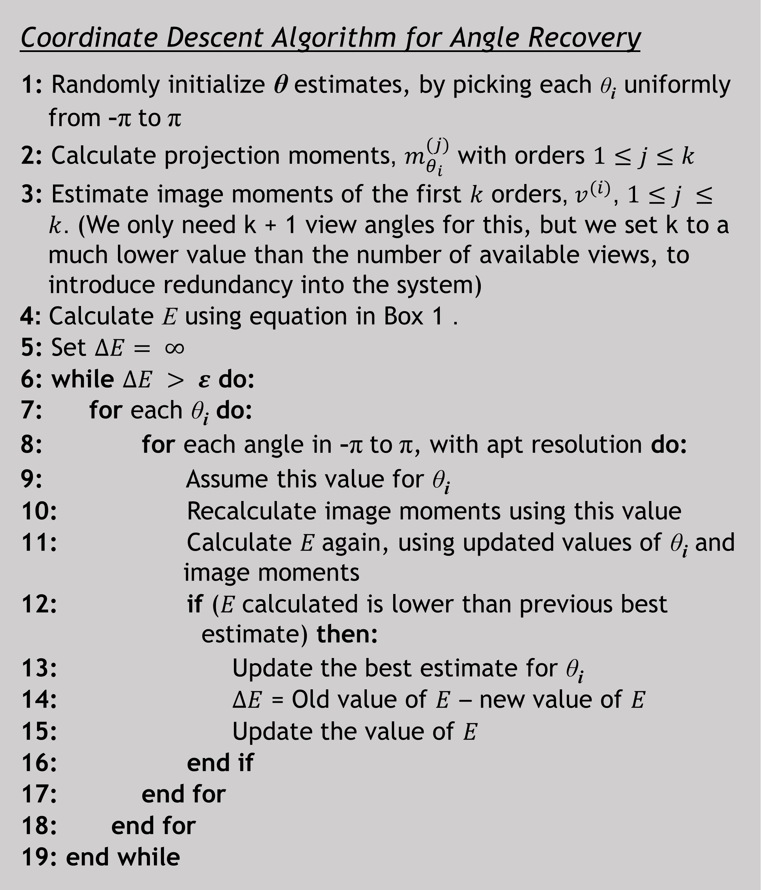
Tomographic Reconstruction from Projections with Unknown View Angles Exploiting Moment-Based Relationships
Eeshan Malhotra, Ajit Rajwade
Indian Institute of Technology Bombay
Introduction
Algorithm - Recovery
Results - Reconstruction
View-angles for tomographic projections are often noisy/unknown
We recover view-angles in scenario when they are completely unknown, with no assumption on angle distribution
Utilize the Helgasson-Ludwig Consistency Conditions (HLCC) - relationship between the geometric moments of the image and projections from a given angle
To obtain consistent estimates for θ, we minimize
Coordinate descent strategy used – iteratively minimized each θ_{i} to converge at best estimate
Coordinate Descent Algorithm for Angle Recovery
1: Randomly initialize θ estimates, by picking each θ_{i} uniformly from -π to π
2: Calculate projection moments, $m_{θ_{i}}^{(j)}$ with orders $1≤j≤k$
3: Estimate image moments of the first $k$ orders, $v_{ }^{(i)}$, $1≤j ≤k$. (We only need k + 1 view angles for this, but we set k to a much lower value than the number of available views, to introduce redundancy into the system)
4: Calculate E using equation in Box 1 .
5: Set $∆E= ∞$
6: while $∆E > ε$ do:
7: for each θ_{i} do:
8: for each angle in -π to π, with apt resolution do:
9: Assume this value for θ_{i}
10: Recalculate image moments using this value
11: Calculate $E$again, using updated values of θ_{i} and image moments
12: if ($E$calculated is lower than previous best estimate) then:
13: Update the best estimate for θ_{i}
14: $∆E$ = Old value of $E$ – new value of $E$
15: Update the value of $E$
16: end if
17: end for
18: end for
19: end while
FBP reconstruction using non-uniform distribution of original angles
30 angles
100 angles
100 angles
5% noise
Actual Angles
5% noise
Estimated Angles
10% noise
Actual Angles
10% noise
Estimated Angles
Algorithm - Denoising
Patch-based PCA denoising method
Fixed size patches considered in a moving window along each projection
For set of L ‘most similar’ patches to patch p eigen-coefficients obtained using PCA
For denoising, Wiener-like updates performed on each patch
Patch based approach captures similarity even in non-analogous parts of two projections
Works well even when total number of projections is very low
Results - Angle Recovery Accuracy
Conclusions
Proposed a general, robust method for image reconstruction from projections from unknown views
Empirically demonstrated efficiency in a variety of scenarios:
With varying number of view angles
With different distributions for generation of the view angles
At multiple noise levels
Key idea: Iteratively improve angle estimates to reduce residuals
in HLCC, using coordinate descent.
Applications in CryoEM, insect tomography, adjusting for patient motion in medical tomography
Uniform Distribution
Non-uniform Distribution
Peaky Distribution

